Slide 1

Reinforcement Learning & Dynamic Programming
AINT351 Machine Learning
Ian Howard and Torbjorn Dahl

Slide 2
Reinforcement Learning
Learning what to do when
What
Actions
When
State
Feedback
Reward

Slide 3
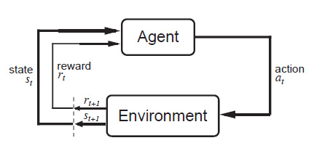
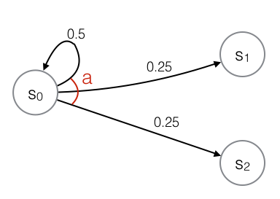
Representing a Problem
Markov Decision Processes (MDPs)
S – Set of states
A – Set of actions
T – Transition function
R – Reward function

Slide 4
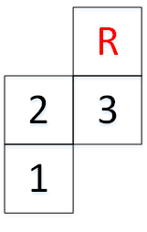
Grid Worlds
States
1, 2, 3
Actions
north (1), east (2), south (3), west (4)
Reward
10 if s = 3 and a = 1
0 otherwise

Slide 5
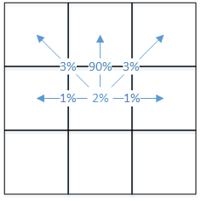
Probabilistic Actions
Given a state, s, and action, a, the resulting state, s’ is a probability distribution over the states

Slide 6
Transition Function
Model of the environment
S | A | S’=1 | S’=2 | S’=3
1 | 1 | 0.07 | 0.9 | 0.03
1 | 2 | 0.96 | 0.01 | 0.03
1 | 3 | 1.0 | 0.0 | 0.0
1 | 4 | 0.99 | 0.01 | 0.0
2 | 1 | 0.0 | 0.96 | 0.01
2 | 2 | 0.01 | 0.06 | 0.9
2 | 3 | 0.9 | 0.09 | 0.01
2 | 4 | 0.01 | 0.99 | 0.0
3 | 1 | 0.0 | 0.01 | 0.09
3 | 2 | 0.0 | 0.0 | 0.99
3 | 3 | 0.03 | 0.01 | 0.96
3 | 4 | 0.03 | 0.9 | 0.06

Slide 7
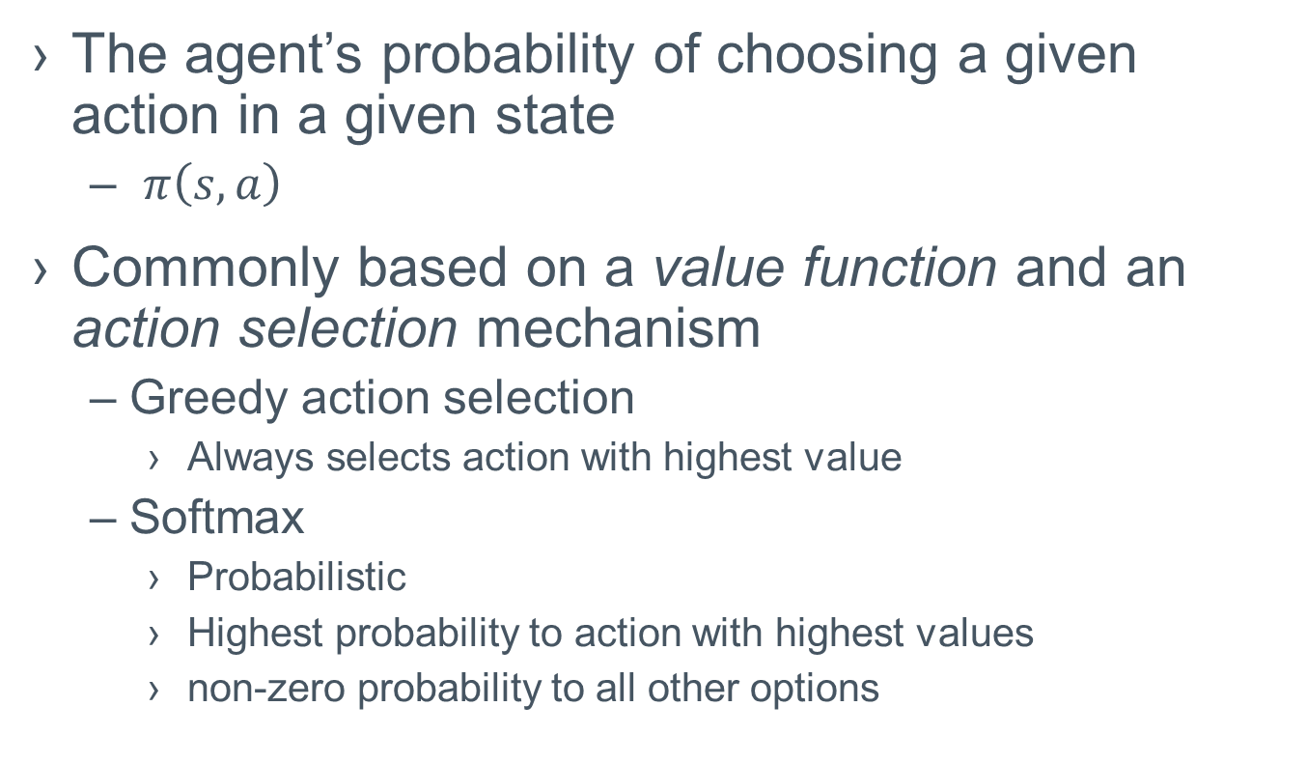
Policies
The agent’s probability of choosing a given action in a given state
$π\left(s,a\right)$
Commonly based on a value function and an action selection mechanism
Greedy action selection
Always selects action with highest value
Softmax
Probabilistic
Highest probability to action with highest values
non-zero probability to all other options

Slide 8
Example Policies
Deterministic
Probabilistic (Random)
policy | action
state | 1 | 2 | 3 | 4 | sum
1 | 1.0 | 0.0 | 0.0 | 0.0 | 1
2 | 0.0 | 1.0 | 0.0 | 0.0 | 1
3 | 1.0 | 0.0 | 0.0 | 0.0 | 1
policy | action
state | 1 | 2 | 3 | 4 | sum
1 | 0.303931 | 0.362078 | 0.316766 | 0.017224 | 1
2 | 0.312981 | 0.330732 | 0.322725 | 0.033562 | 1
3 | 0.060054 | 0.22954 | 0.320982 | 0.389424 | 1

Slide 9
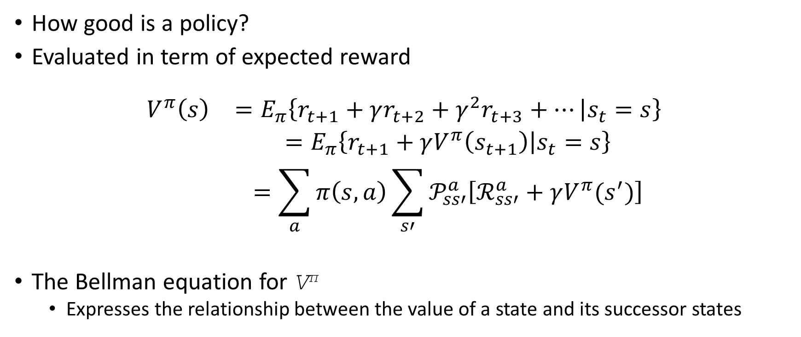
State-Value Functions
How good is a policy?
Evaluated in term of expected reward
$$\begin{matrix}V^{π}\left(s\right) & =E_{π}\left\{r_{t+1}+γr_{t+2}+γ^{2}r_{t+3}+… | s_{t}=s\right\} \\ & =E_{π}\left\{r_{t+1}+γV^{π}\left(s_{t+1}\right) | s_{t}=s\right\} \\ & =\sum_{a}{π\left(s,a\right)\sum_{s′}{𝒫_{ss′}^{a}\left[ℛ_{ss′}^{a}+γV^{π}(s^{′})\right]}}\end{matrix}$$
The Bellman equation for V^{π}
Expresses the relationship between the value of a state and its successor states

Slide 10
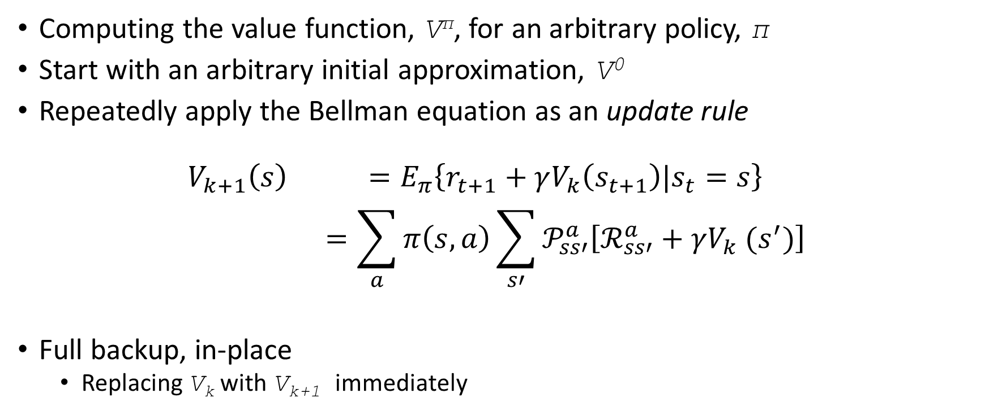
Policy Evaluation
Computing the value function, V^{π}, for an arbitrary policy, π
Start with an arbitrary initial approximation, V⁰
Repeatedly apply the Bellman equation as an update rule
$$\begin{matrix}V_{k+1}\left(s\right) & =E_{π}\left\{r_{t+1}+γV_{k}\left(s_{t+1}\right)|s_{t}=s\right\} \\ & =\sum_{a}{π\left(s,a\right)\sum_{s′}{𝒫_{ss′}^{a}\left[ℛ_{ss′}^{a}+γV_{k} (s^{′})\right]}}\end{matrix}$$
Full backup, in-place
Replacing V_{k} with V_{k+1} immediately

Slide 11
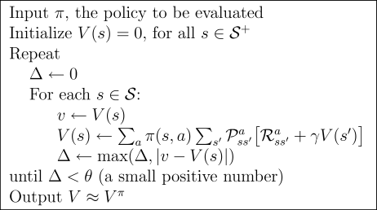
Iterative Policy Evaluation Algorithm

Slide 12
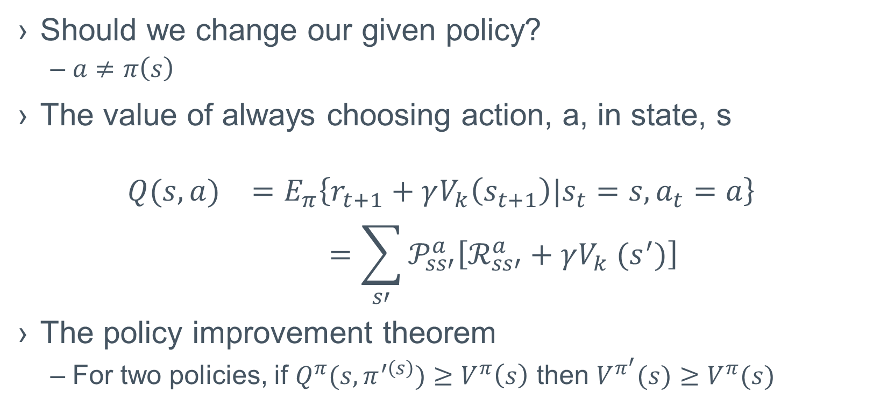
Policy Improvement
Should we change our given policy?
$a≠π\left(s\right)$
The value of always choosing action, a, in state, s
$$\begin{matrix}Q(s,a) & =E_{π}\left\{r_{t+1}+γV_{k}\left(s_{t+1}\right)|s_{t}=s,a_{t}=a\right\} \\ & =\sum_{s′}{𝒫_{ss′}^{a}\left[ℛ_{ss′}^{a}+γV_{k} (s^{′})\right]}\end{matrix}$$
The policy improvement theorem
For two policies, if $Q^{π}(s,π^{′\left(s\right)})≥V^{π}\left(s\right)$ then $V^{π^{′}}(s)≥V^{π}(s)$

Slide 13

Policy Iteration
Alternate policy evaluation and improvement
Guaranteed improvement

Slide 14
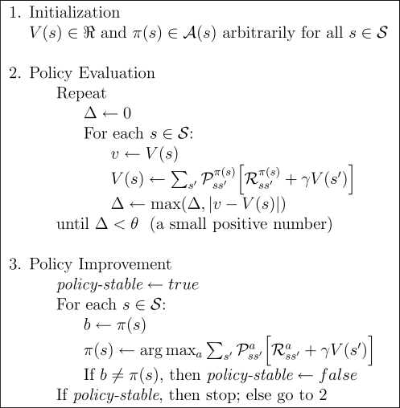
Policy Iteration Algorithm

Slide 15
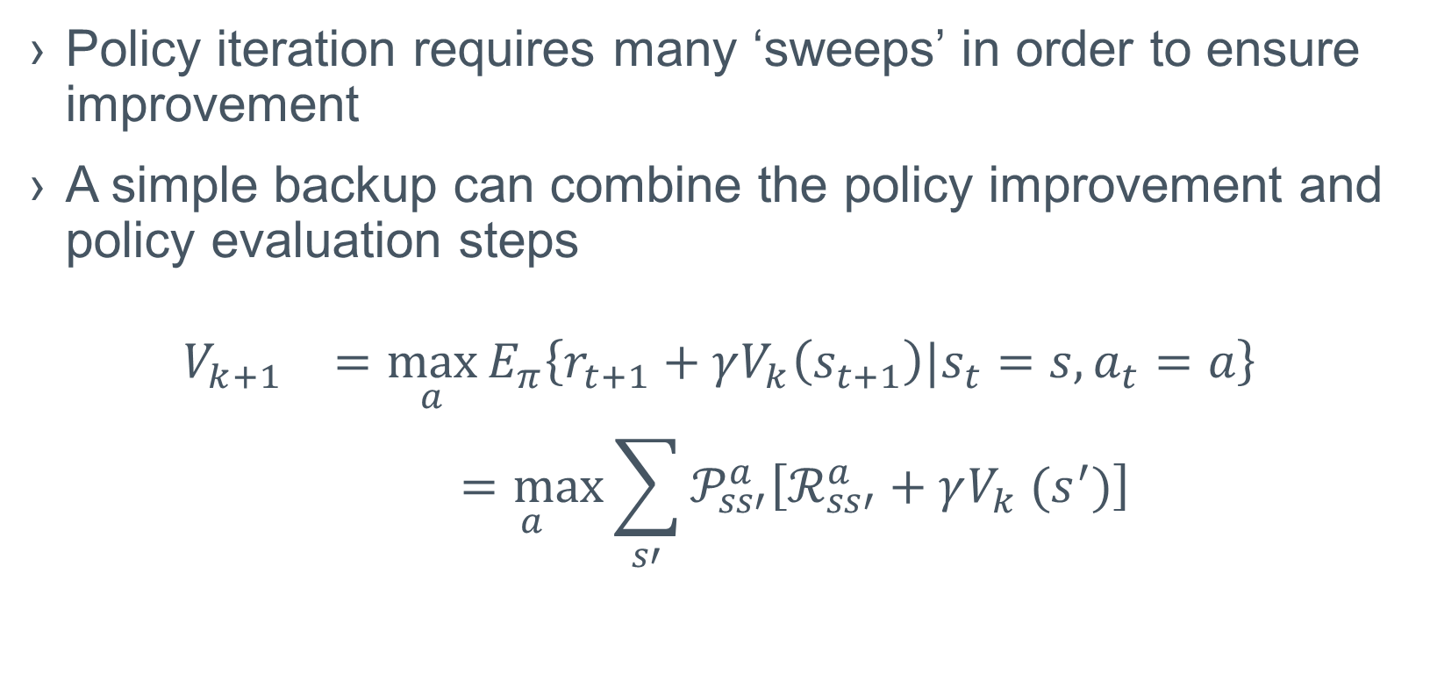
Value Iteration
Policy iteration requires many ‘sweeps’ in order to ensure improvement
A simple backup can combine the policy improvement and policy evaluation steps
$$\begin{matrix}V_{k+1} & =\max_{a}{E_{π}\left\{r_{t+1}+γV_{k}\left(s_{t+1}\right)|s_{t}=s,a_{t}=a\right\}} \\ & \underset{a}{=max}{\sum_{s′}{𝒫_{ss′}^{a}\left[ℛ_{ss′}^{a}+γV_{k} (s^{′})\right]}}\end{matrix}$$

Slide 16
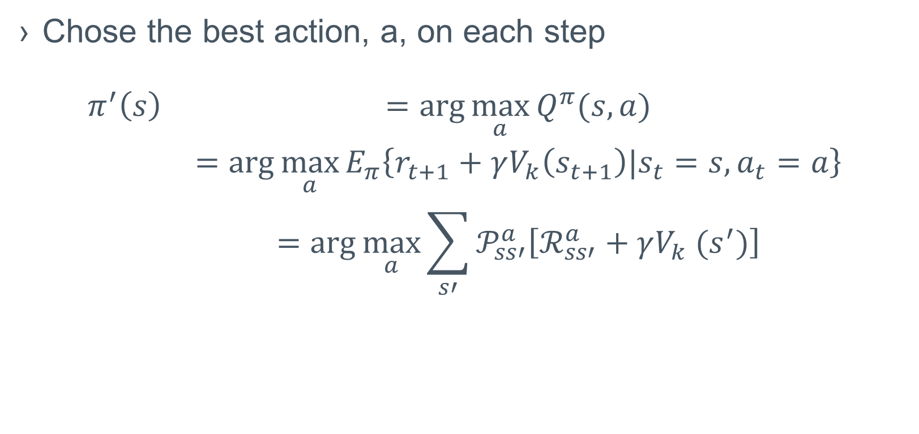
A Greedy Policy
Chose the best action, a, on each step
$$\begin{matrix}π^{′}\left(s\right) & =\arg{\max_{a}{Q^{π}(s,a)}} \\ & =arg{\max_{a}{E_{π}\left\{r_{t+1}+γV_{k}\left(s_{t+1}\right)|s_{t}=s,a_{t}=a\right\}}} \\ & =arg{\max_{a}{\sum_{s′}{𝒫_{ss′}^{a}\left[ℛ_{ss′}^{a}+γV_{k} (s^{′})\right]}}}\end{matrix}$$

Slide 17
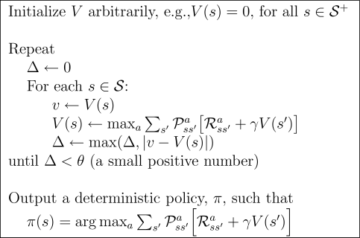
Value Iteration Algorithm

Slide 18
Summary
Given an RL problem
S, Set of states
A, Set of actions
T, Transition function
R, Reward function
Can calculate optimal policy and its value using
Policy Iteration
Value Iteration
What if we don’t know the transition function?
Finally, learning!

